Slide 1
How will the MOOC Change Between Now and 2020?
Charles Severance
Notre Dame Digital Education Week
7-October-2014
Notes:
Total students: 363K, paid 3325 1/10 finished 1/100 paid 150K students 1486 books wholesale for my book $3.82

Slide 2
One of these things is not like the others:
www.masteringphysics.com
www.masteringastronomy.com
www.masteringpython.com

Slide 3
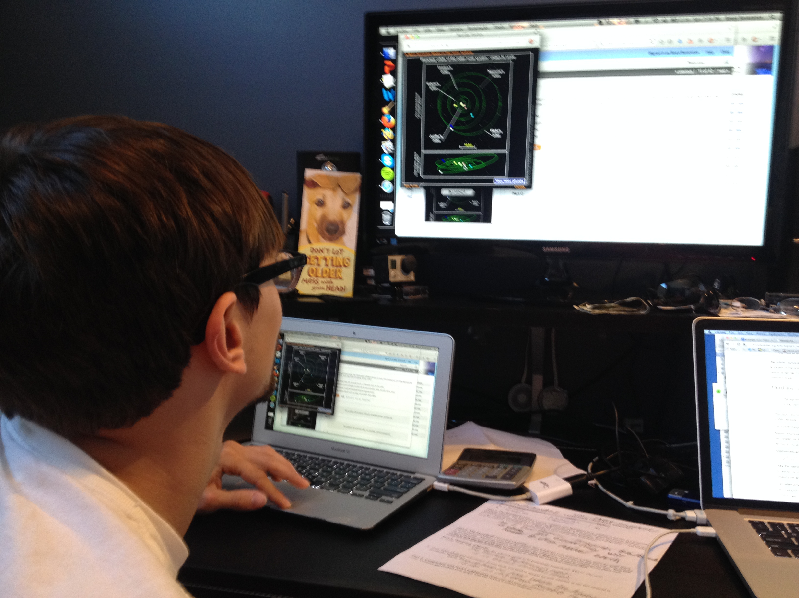

Slide 4
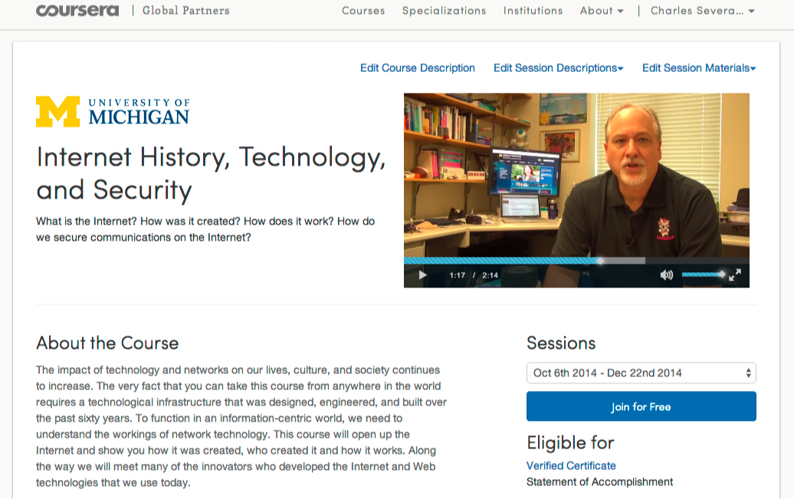

Slide 5
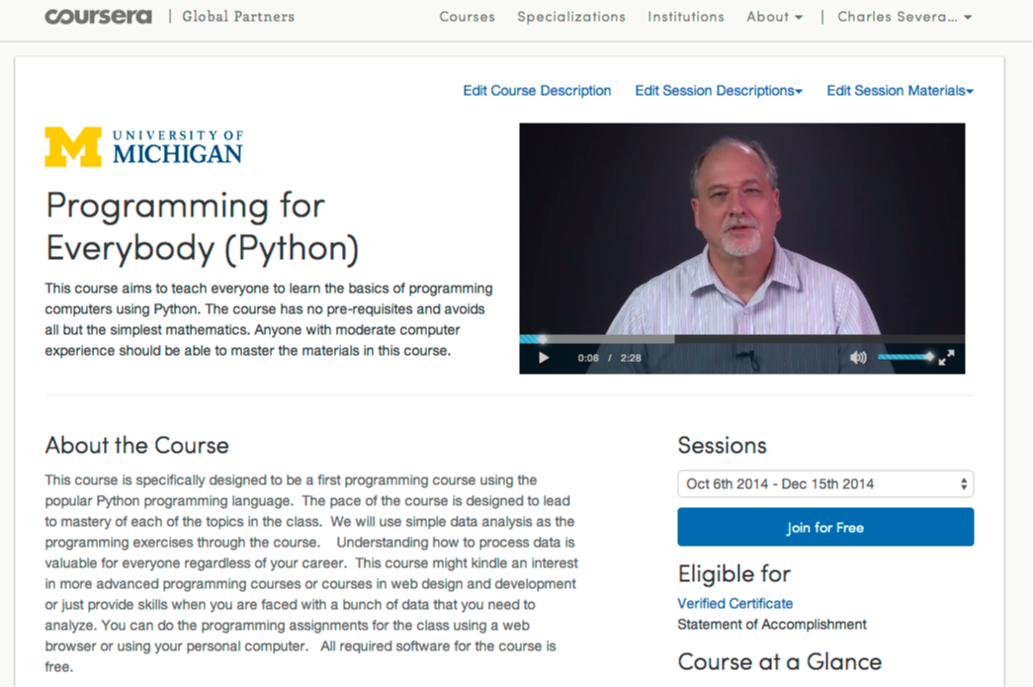

Slide 6
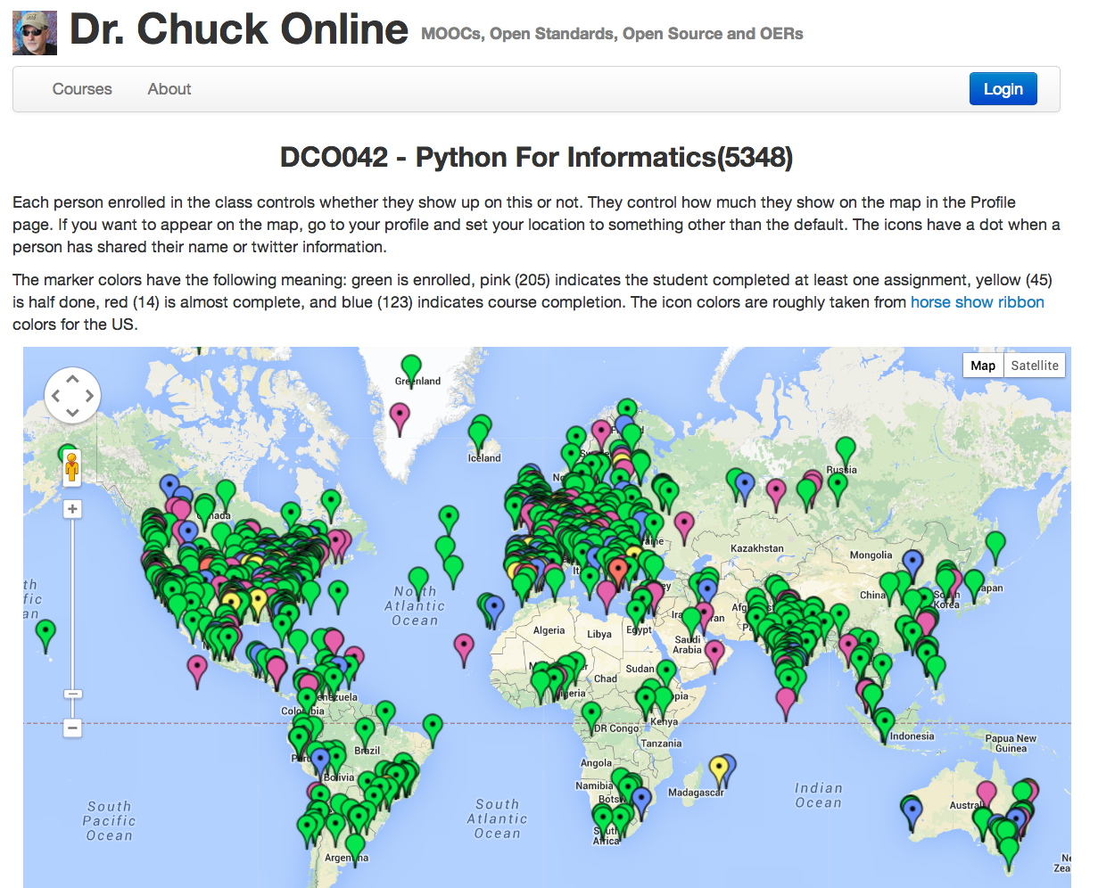

Slide 7
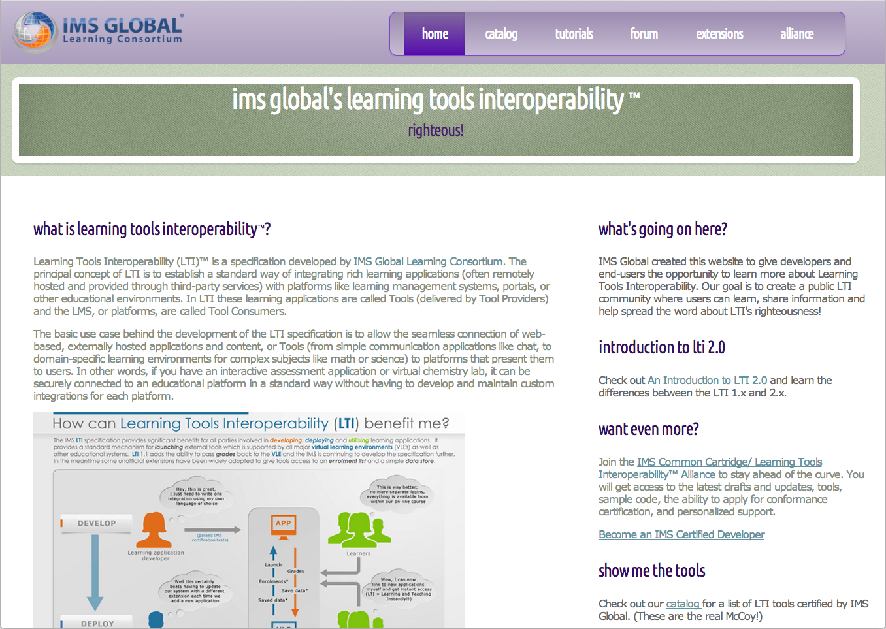
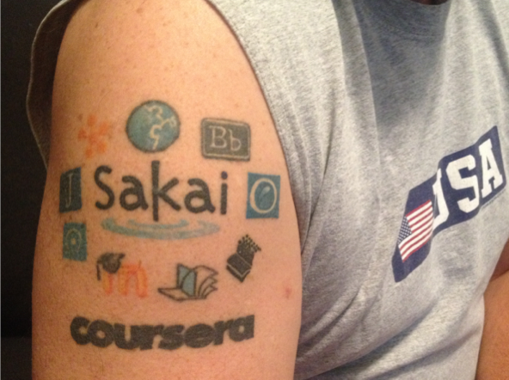
Notes:
Actually I do have a clue... Note Coursera logo.

Slide 8
Game On....
Notes:
What is wrong with this picture??

Slide 9
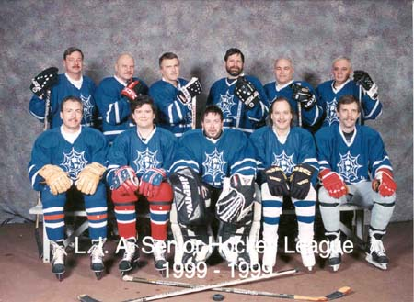
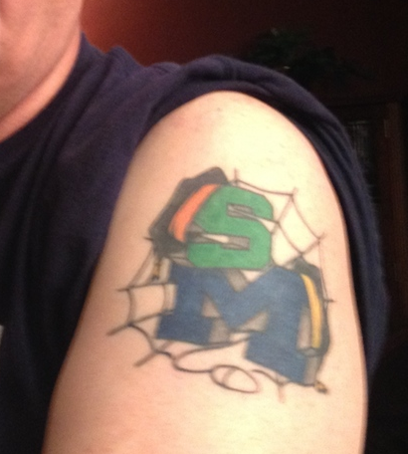

Slide 10
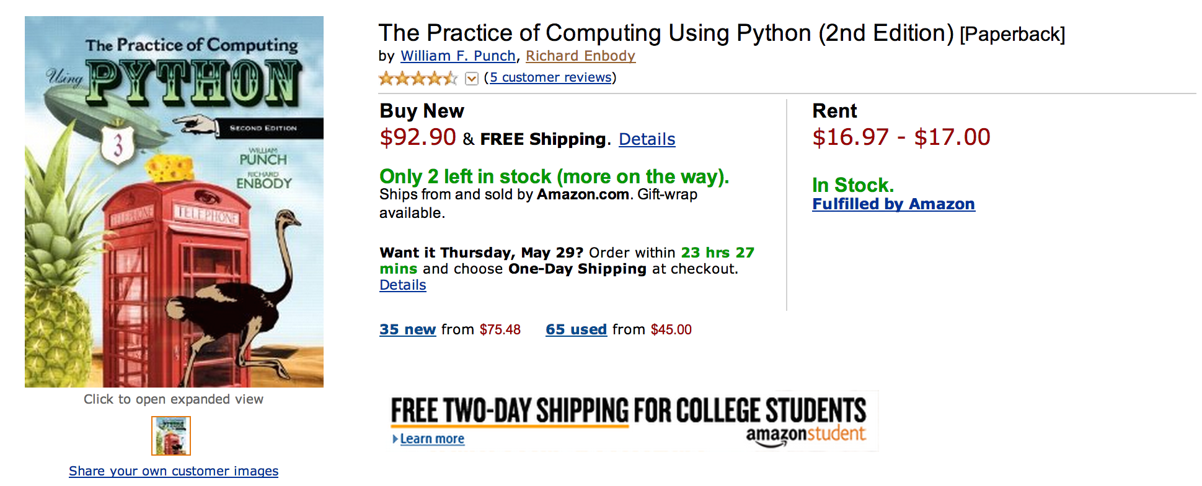
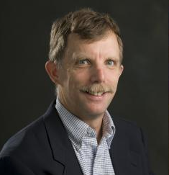
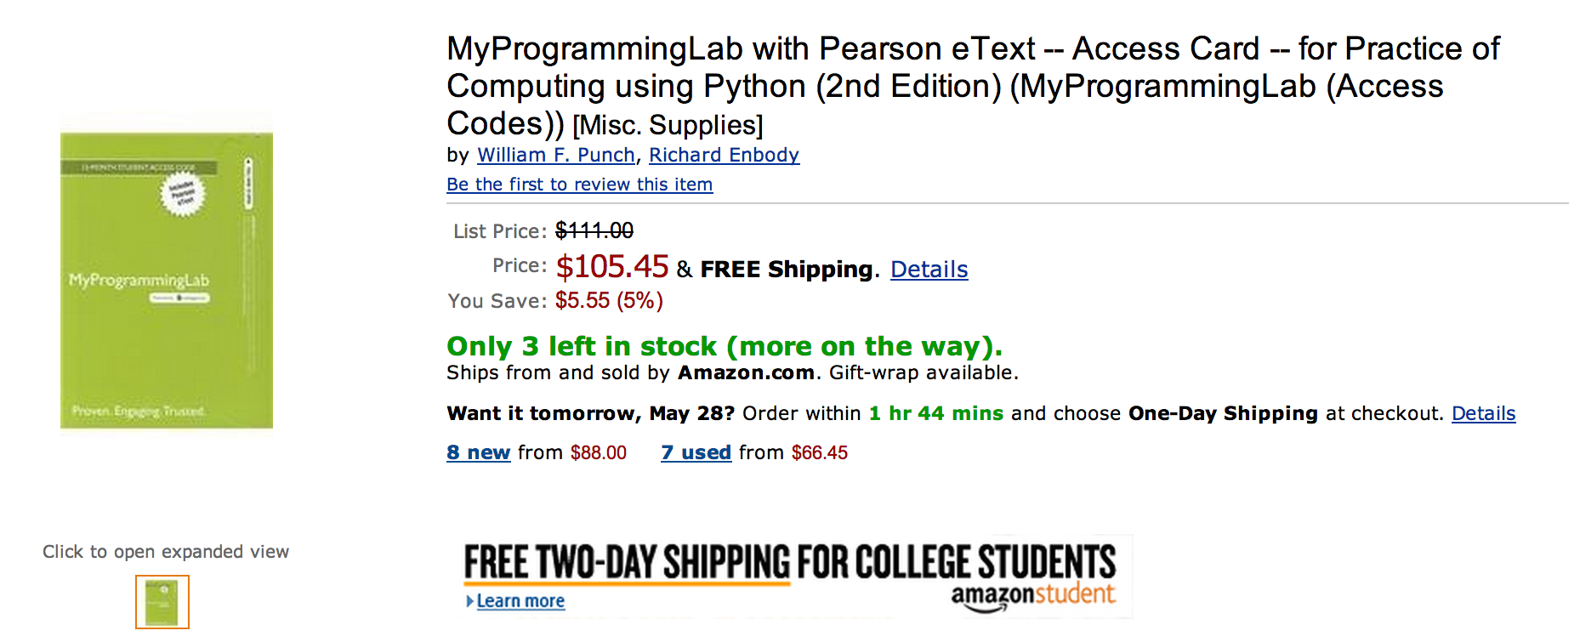

Slide 11
What does $198.35 get you?
Book
Automatic Homework Grading Software
Learning Management System Integration
Instructor Materials
Slides / Solutions Manual / Exams / Course Copy
Instructor Training
3-5 days from notification to full course
Notes:
$65 from Pearson $130 Form bookstore

Slide 12

Teacher Prep
Book
Pearson Value
Proposition
$200
Marketing
Software

Slide 13
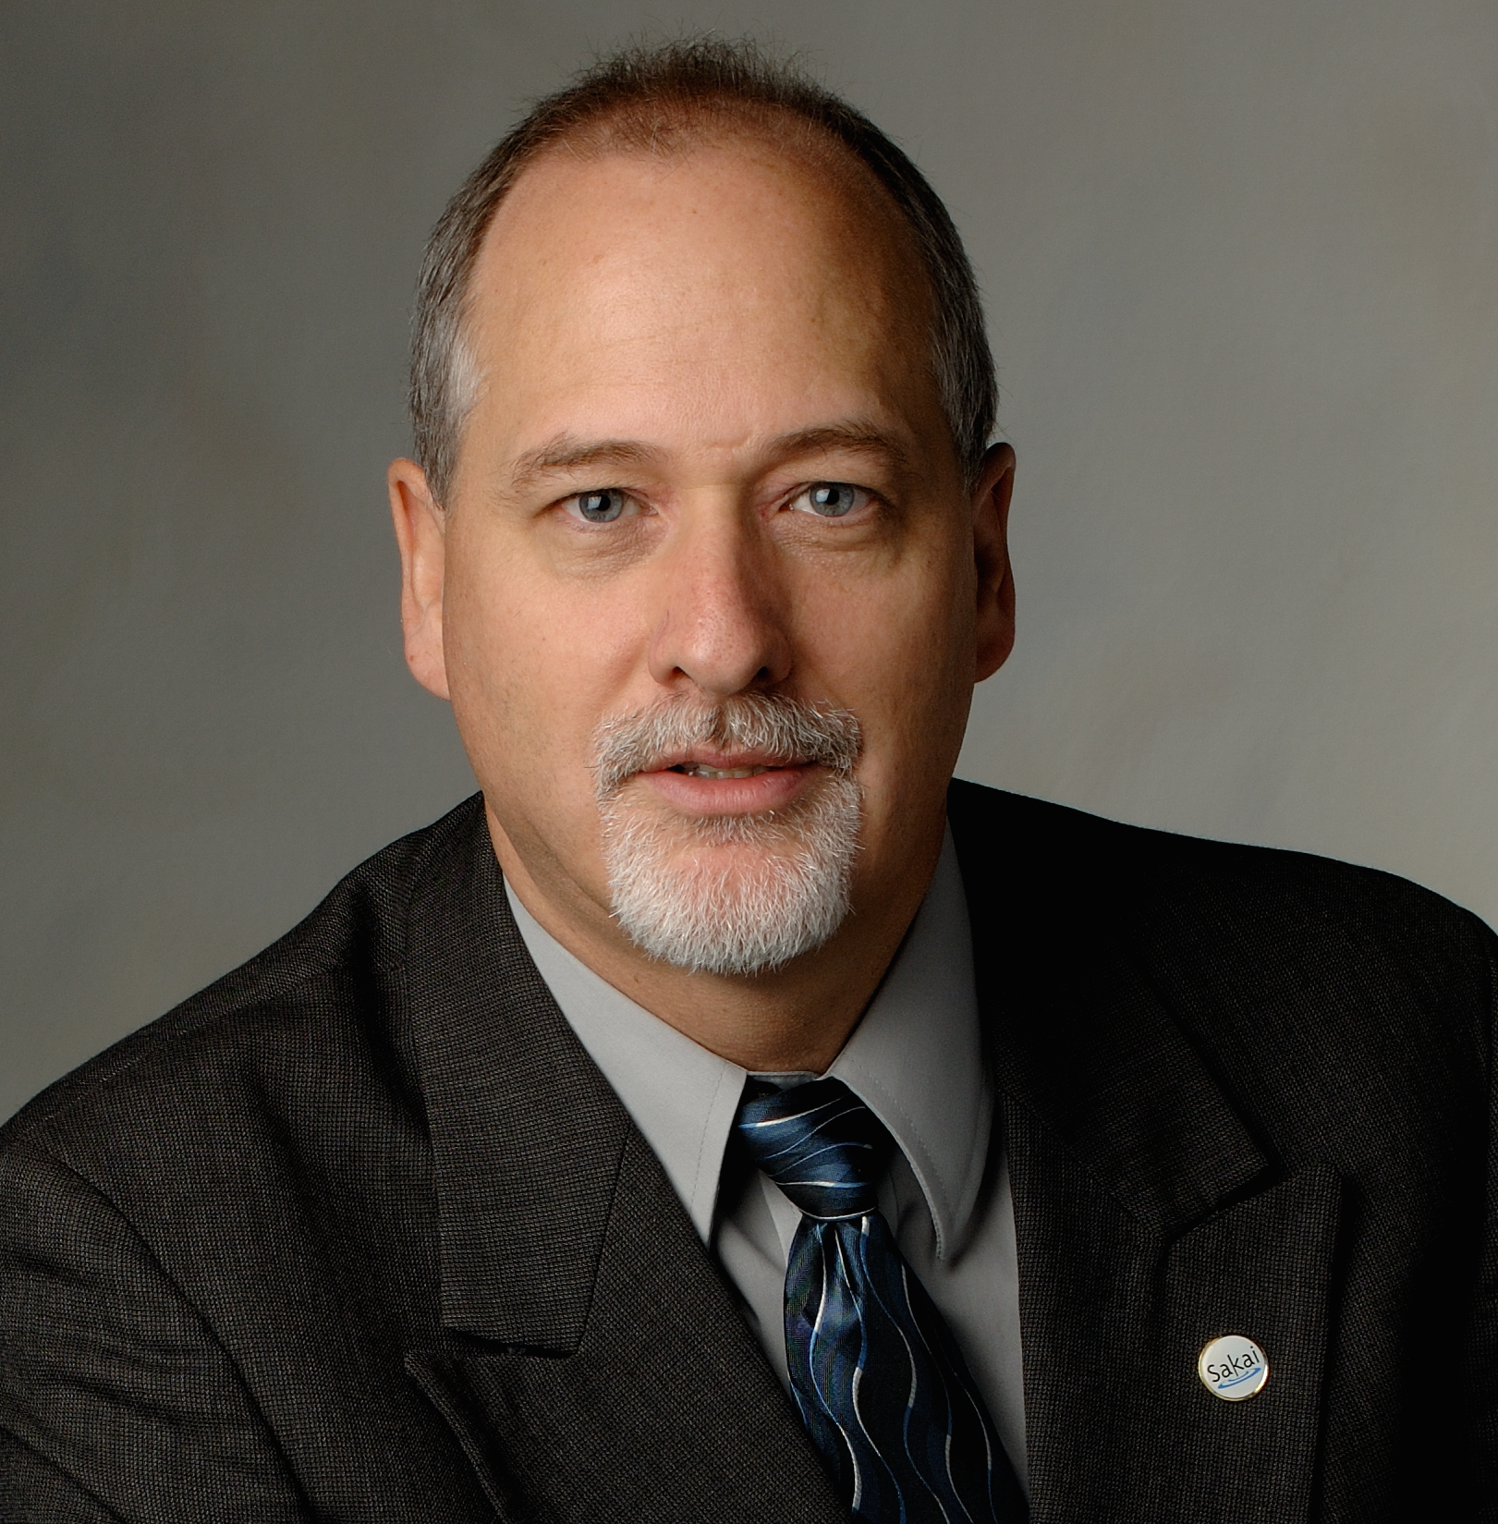
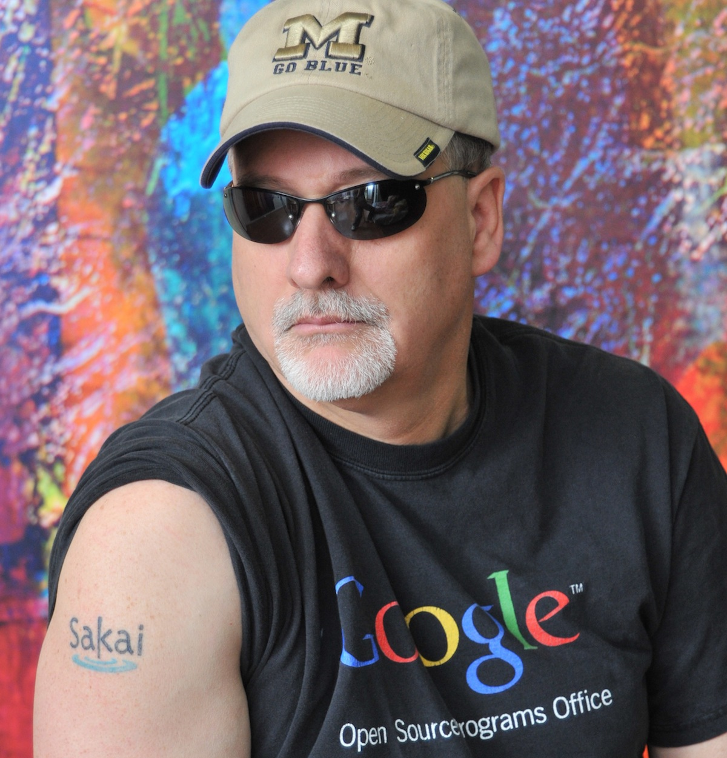




Slide 14
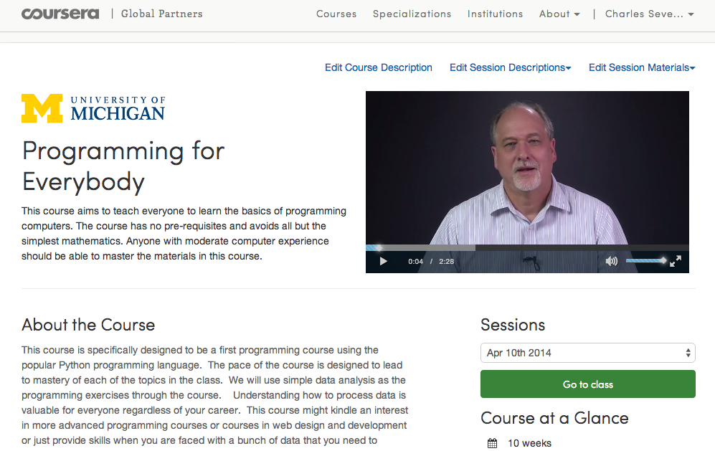

Slide 15
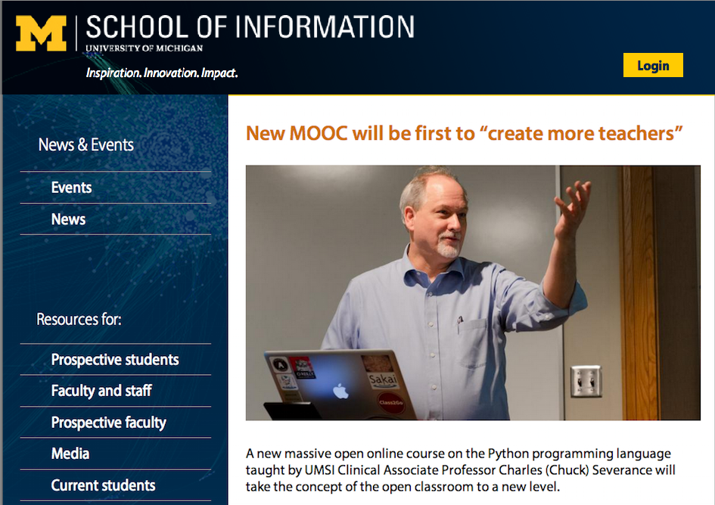

Slide 16
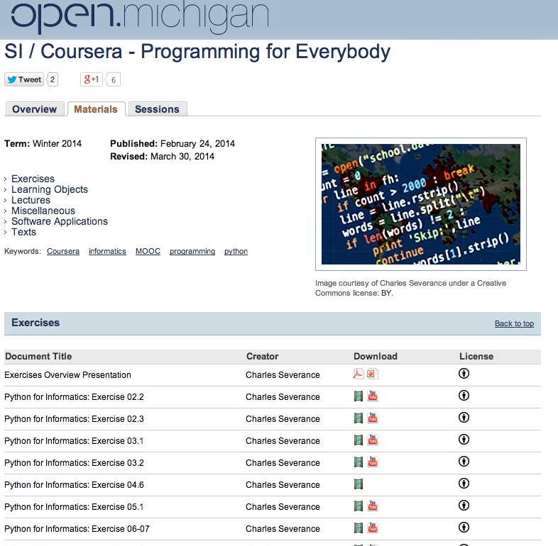

Slide 17
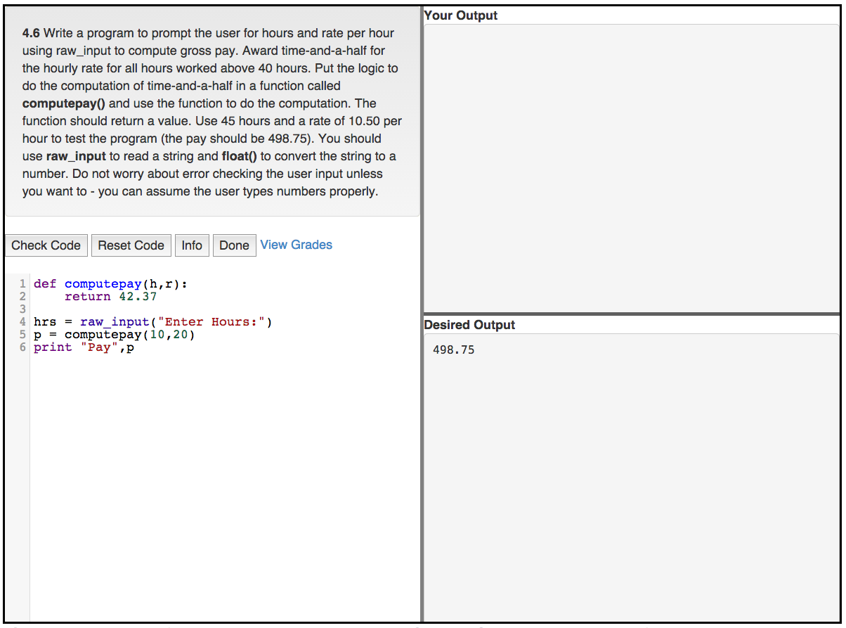

Slide 18
What's Free...
Course Enrollment
Coursera, Dr. Chuck Online, CourseSites, CanvasNet (soon)
Statement of Accomplishment on Coursera
Badge on Dr. Chuck Online
Book: PDF, MOBI, EPUB, iBooks (CC-BY-NC*)
Lecture Slides in editable form (CC-BY)
Lecture Videos in MP4 or YouTube (CC-BY)
Auto-Grader software integrated into any LMS
* I will remove NC for a legitimate translation

Slide 19
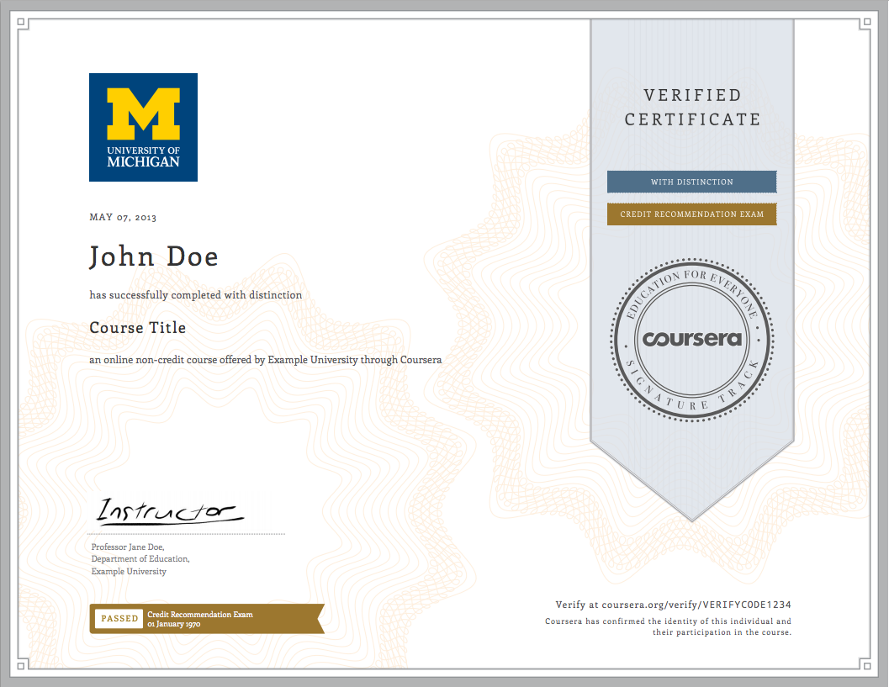
Revenue Model
Print Textbook ($8.99)
Conversion rate 1/200 – Revenue $2.50
Verified Certificates ($40.00)
Conversion rate 1/100 – Revenue $2.00
Session 1: 30497
Session 2: 73,861
Session 3: 73,681

Slide 20
Teacher Prep
Book
Value
Proposition
Software
Free (or $9)
Marketing
Community
Notes:
Will I get

Slide 21
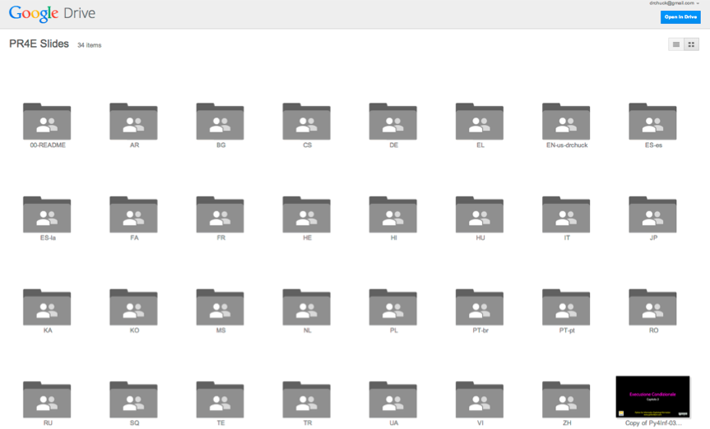
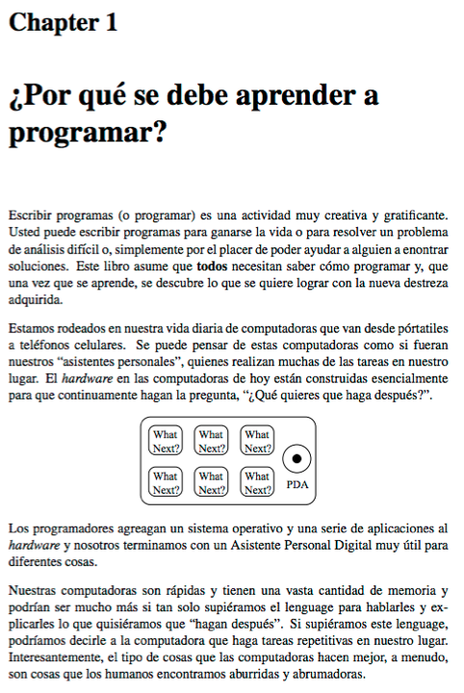
Open / Free has other advantages...
slides.pr4e.org
translate.pr4e.org

Slide 22
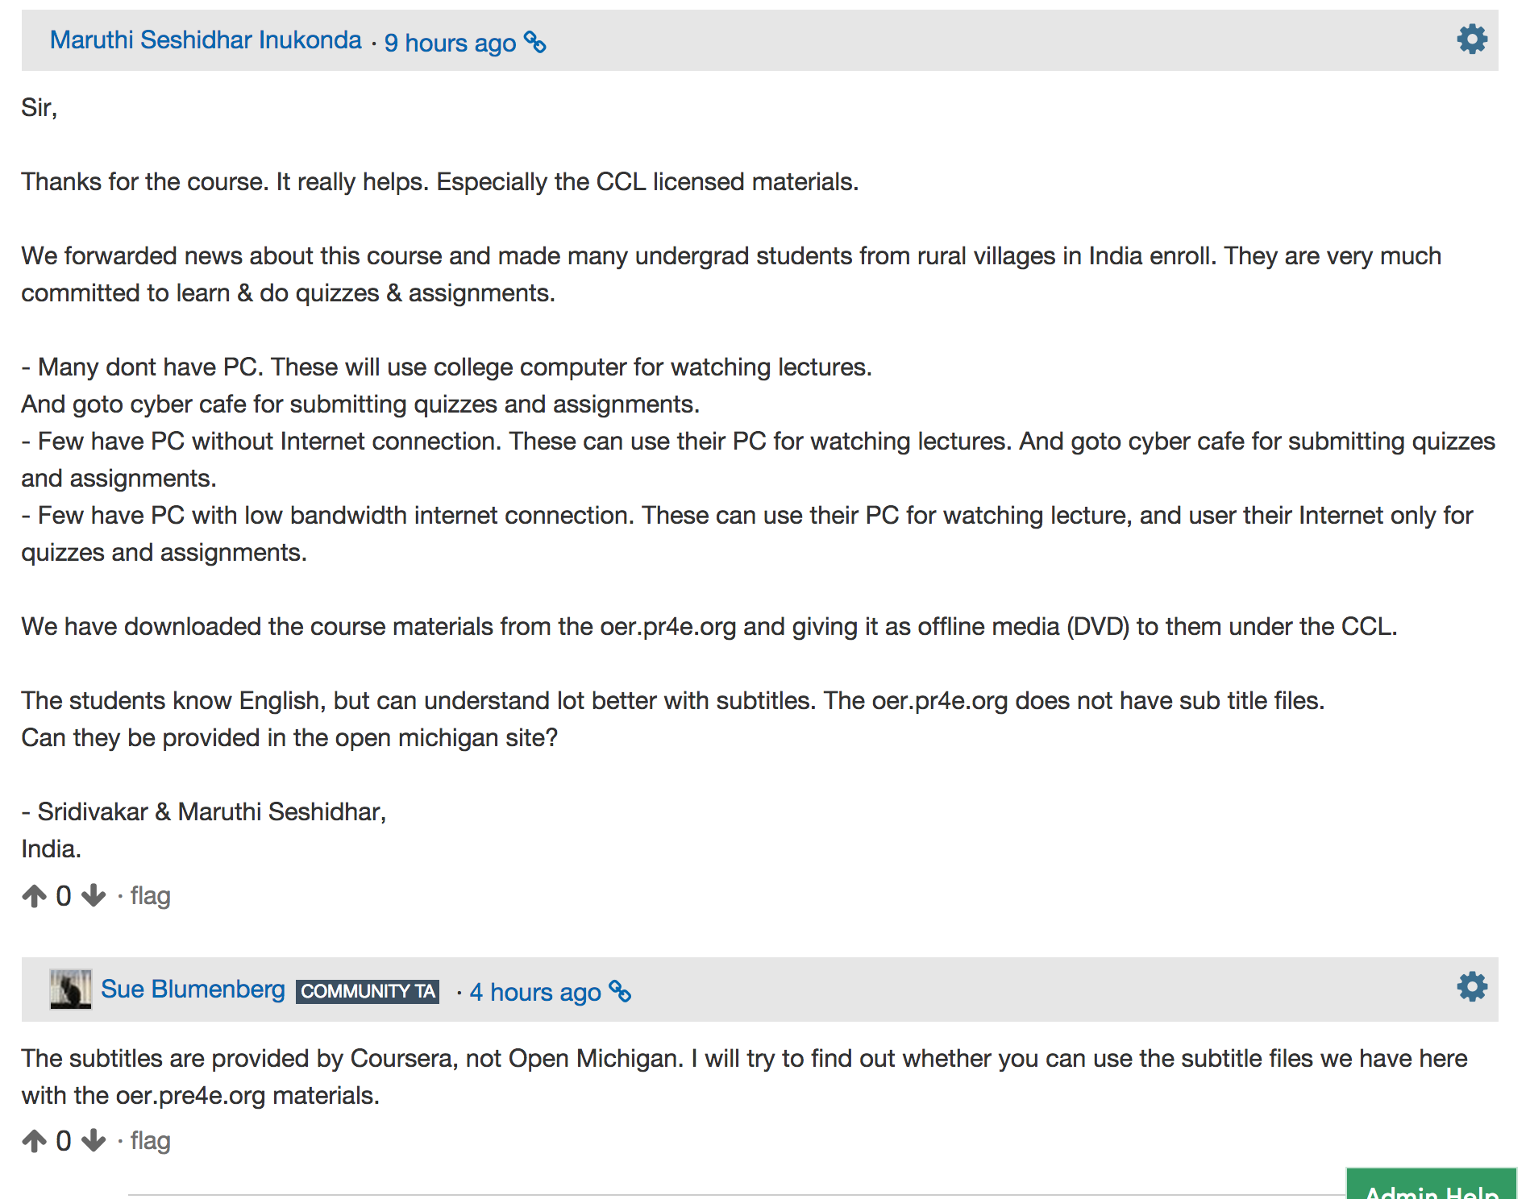

Slide 23
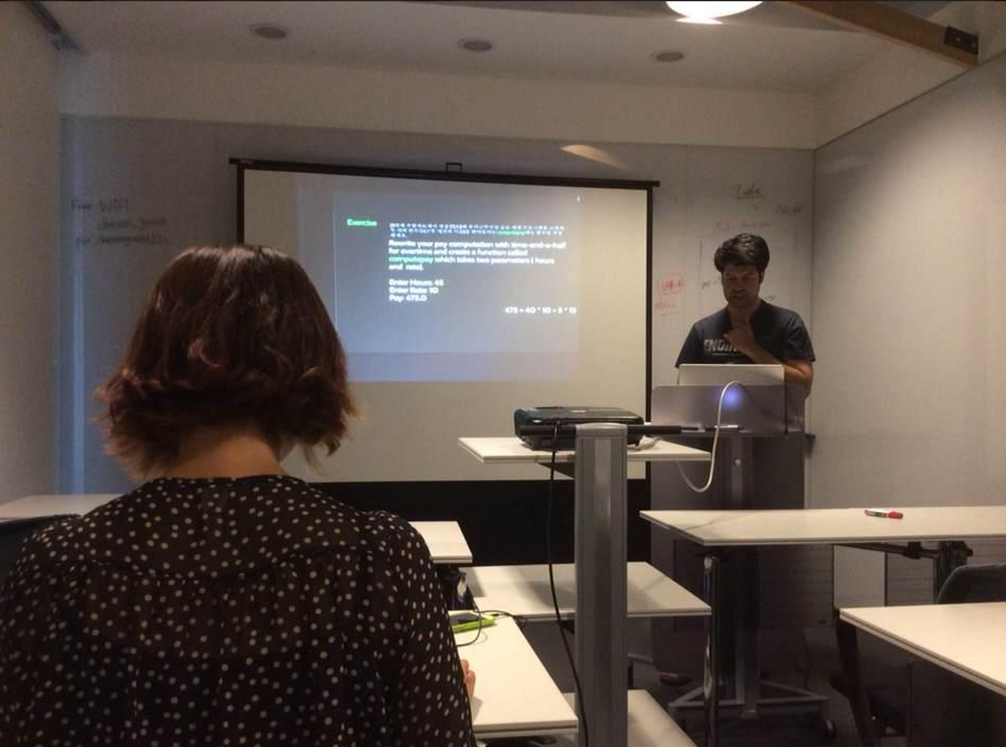
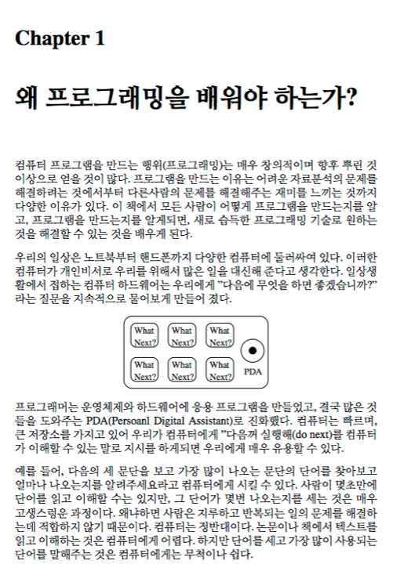
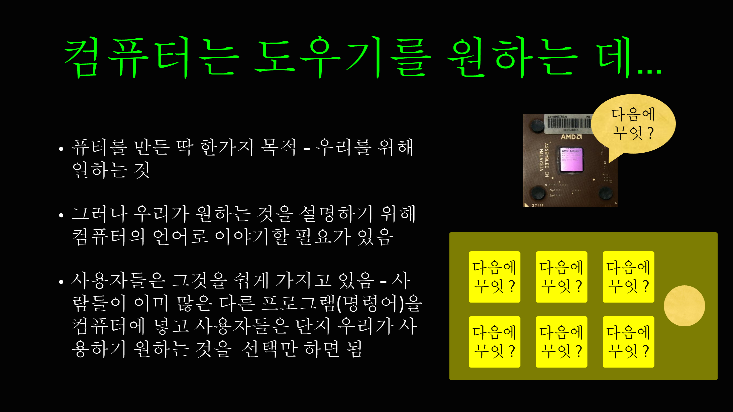


Slide 24
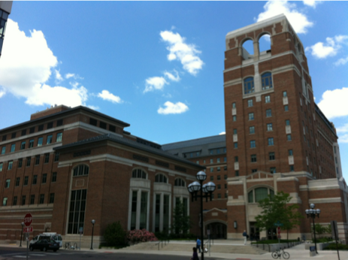

2455 North Quad
North Quad
University of Michigan
Ann Arbor, MI, USA

Slide 25
Looking at Data

Slide 26
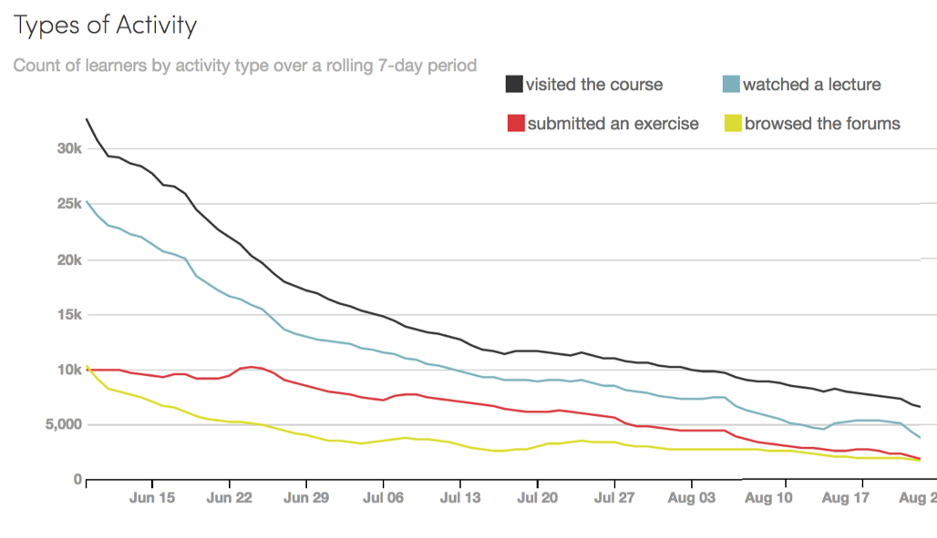
PR4E#002

Slide 27
Start of Registration to Class End
PR4E#002

Slide 28
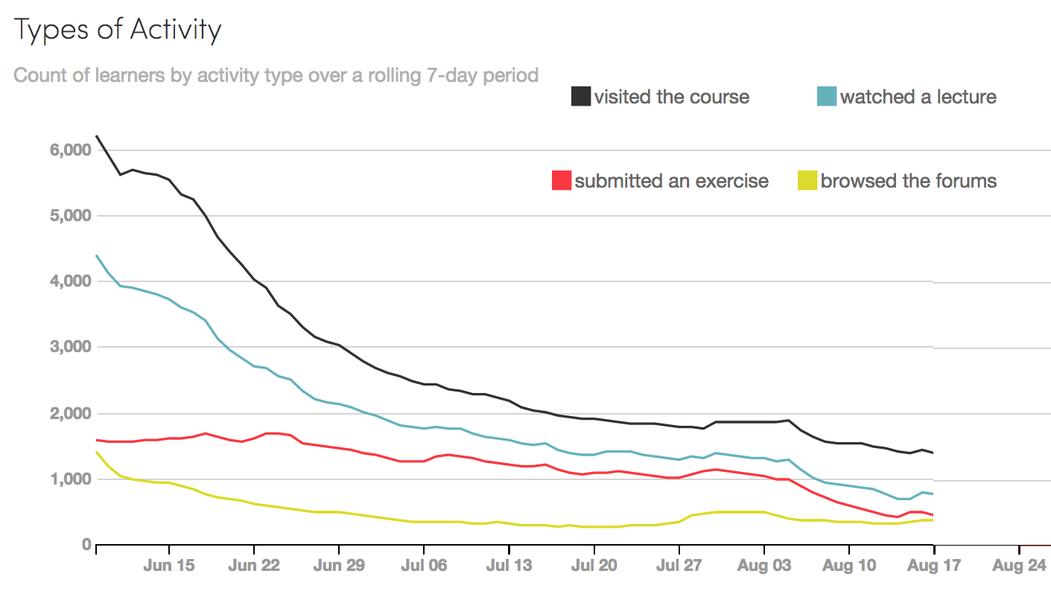
IHTS#006

Slide 29
IHTS#006

Slide 30
Advantages of Scheduled MOOCs
F2F structure maps nicely to MOOC
All students are working on the same homework they can help each other
You get time off between semesters to rework things

Slide 31
Problems With Scheduled MOOCs
Changing dates throughout a class for a new semester is no fun
No good way to test software between classes so first week is always a bit crazy
Students want extensions for extenuating circumstances
Many students know the material and just want the certificate – always asking to go faster
If you make a mistake you need to extend the schedule
Closing down a course for certificate award takes 1-2 days

Slide 32
Self-Paced Technical Issues
Streaming / Social Peer-Grading
Contextualized help by time/topic
Discussion board posts can't last forever – subtle
Schedule allows restart
Content needs so be pretty clean
Schedule allows focus and limits risk
Need a self-sustaining community / culture
Can you ever take time off?
What is the role of the teacher?
Schedule avoids the need to be everywhere at the same time?

Slide 33
Lead Community Teaching Assistants
Sue (CA)
Mazen (Egypt)
Mauro (Italy)
voices.dr-chuck.com

Slide 34
New York, Los Angeles, Ann Arbor, Chicago, Washington DC, Memphis, Seattle, Seoul, Barcelona, London, Mexico City, Amsterdam, Manila Melbourne, Perth...
office-hours.dr-chuck.com
Notes:
Since I have a very active travel schedule, I decided to hold office hours in the major cities I have visited in the past 18 months. I have held office hours in over 15 cities and in each location somewhere between two and 15 students show up.

Slide 35
But when SELF PACED works...

Slide 36
Why not Self Paced Right Away?

Slide 37
Course Development by Semesters
(1) Pick book, develop slides and assignments
(2) Fine tune materials from (1)
(3) Build auto grader, record lectures, mini-flip
(4) Write 250-page book, refine materials
(5) Teach scheduled MOOC
(6) Convert MOOC to self-paced

Slide 38
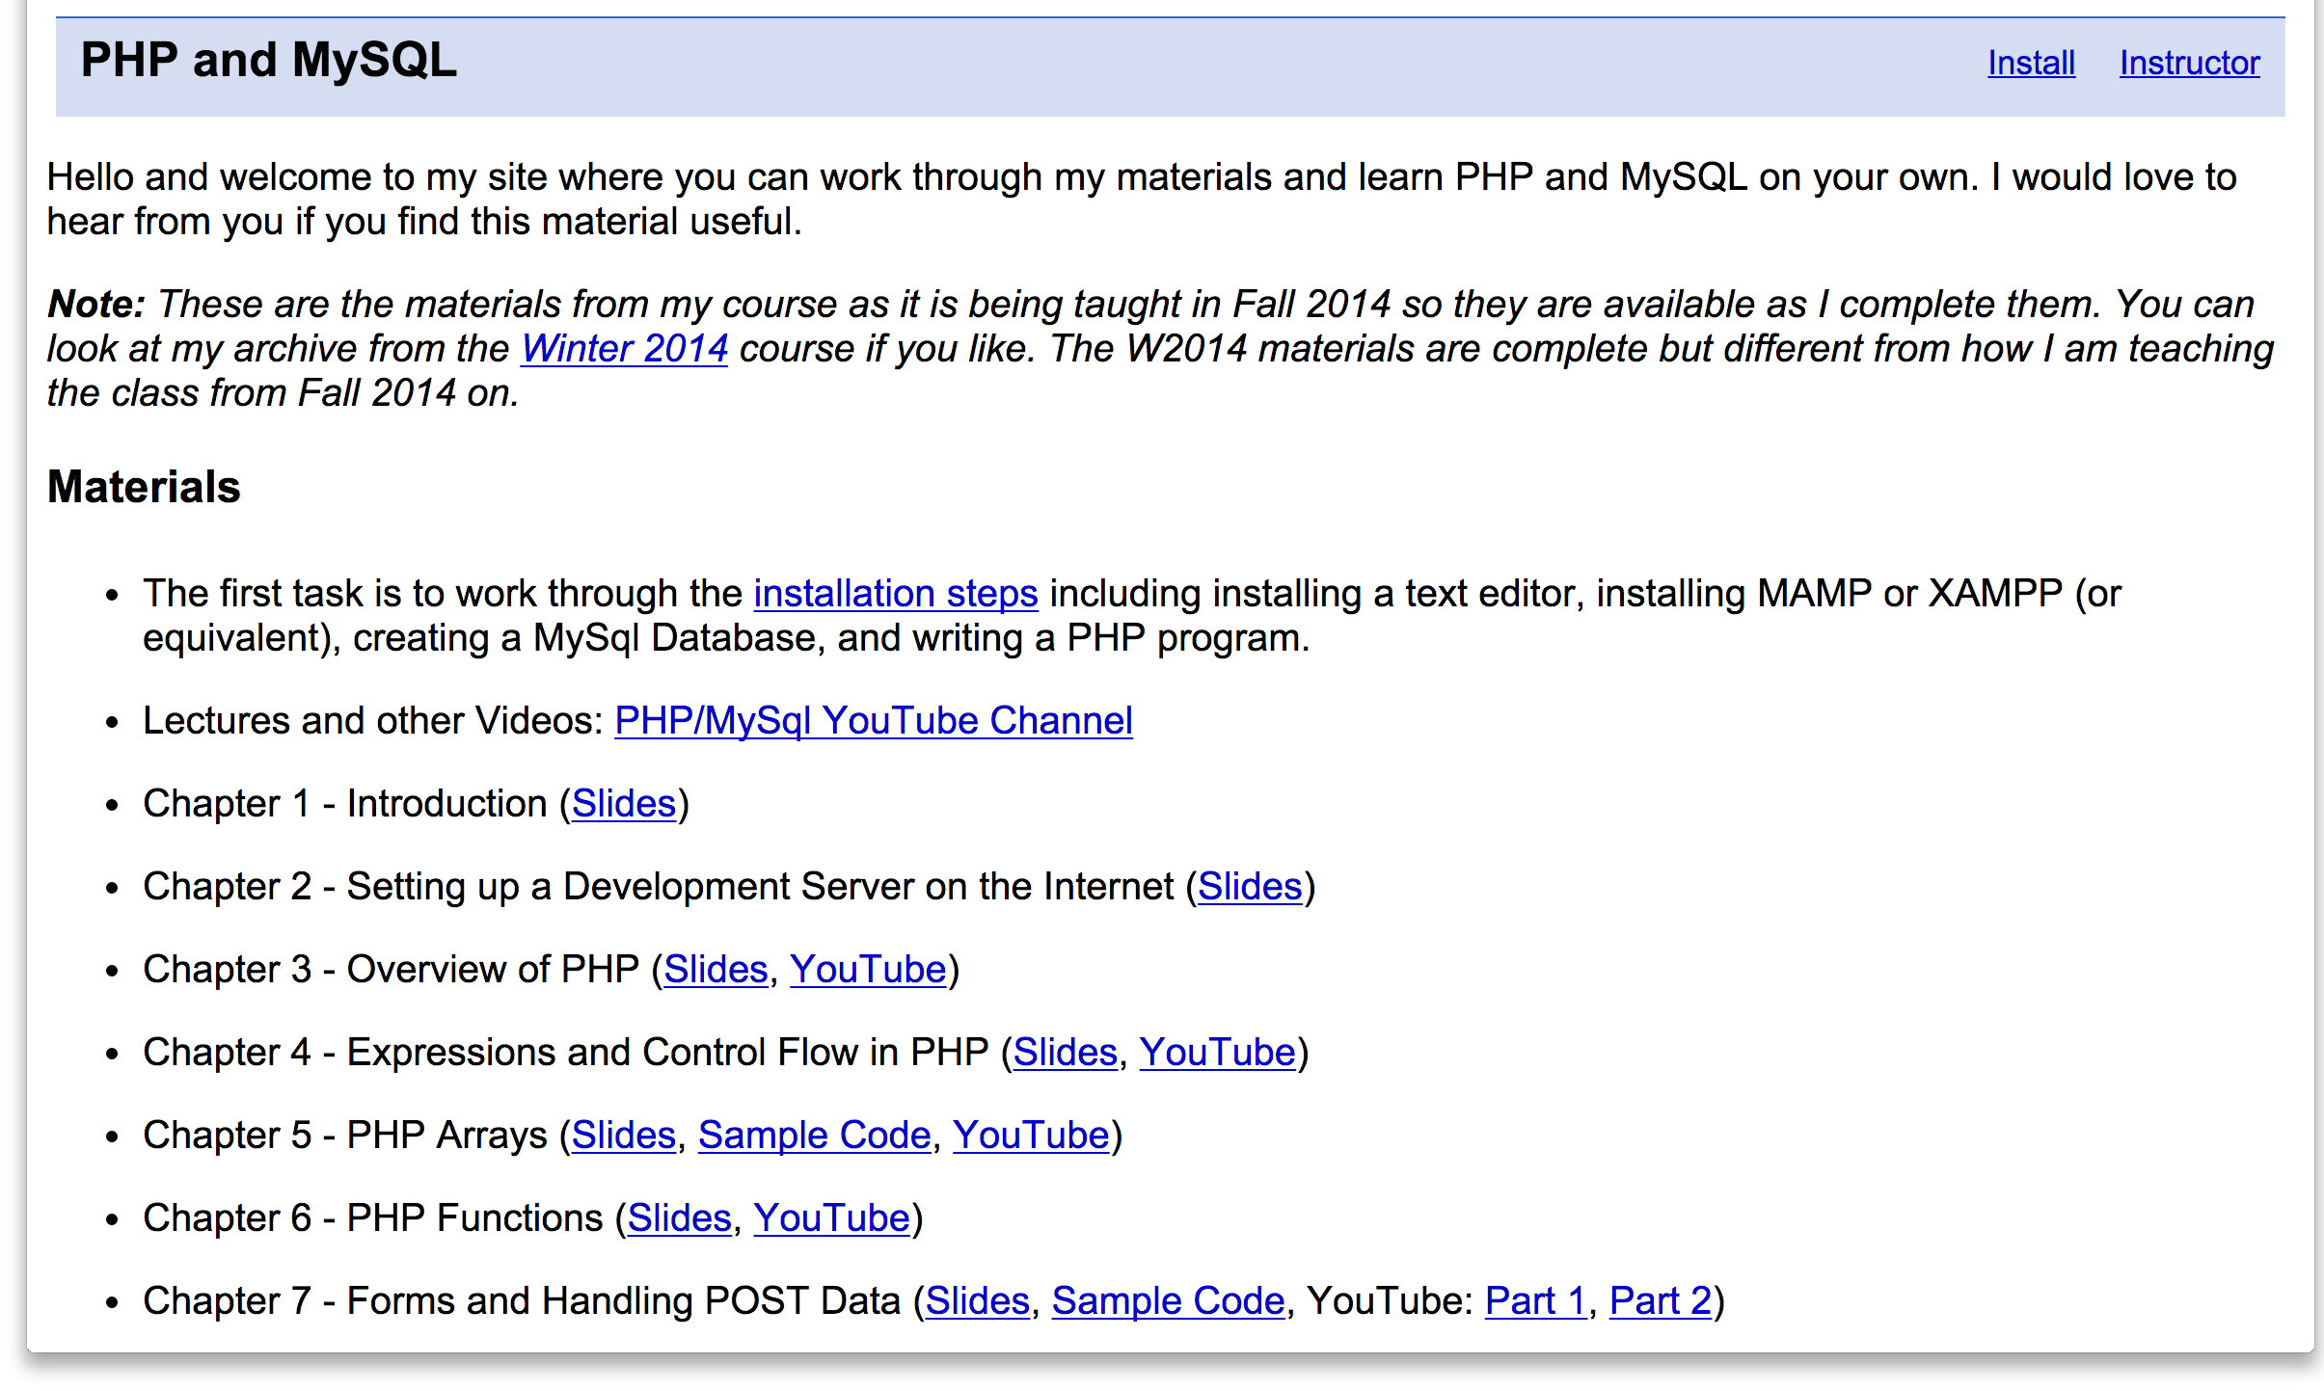
www.php-intro.com

Slide 39
Beyond Self Paced...

Slide 40
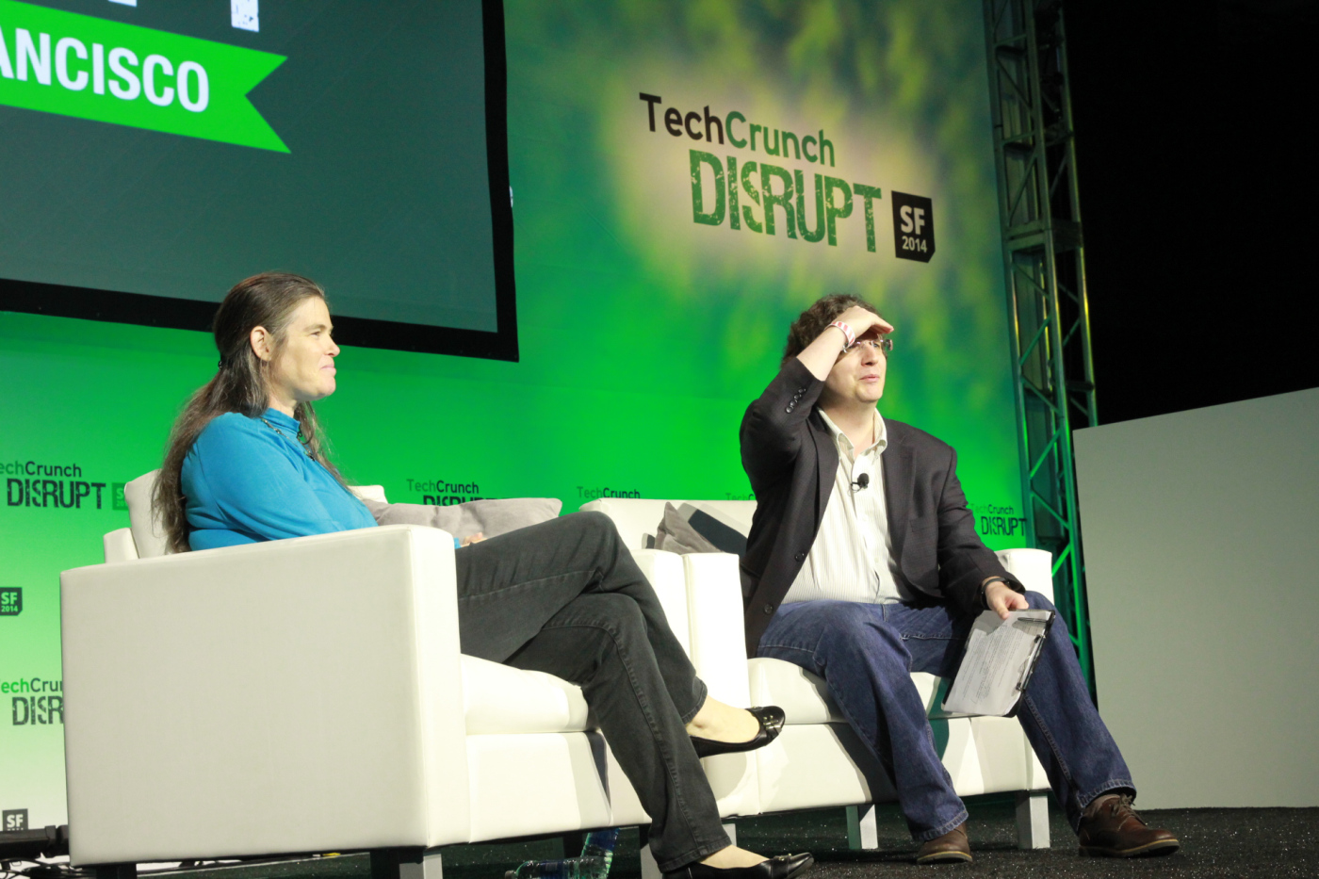
This morning at Disrupt SF, Coursera’s president Daphne Koller pushed back against the notion that her company is a for-profit education company: In her view, Coursera is instead a for-profit technology company.
http://techcrunch.com/2014/09/10/coursera-president-daphne-koller-2014-is-the-year-moocs-will-come-of-age/

Slide 41
Questions...

